Slide 1

KCS056 APPLICATION OF
SOFT COMPUTING
UNIT-2
Prepared By- MR. Ashish Tiwari
ASSISTANT PROFESSOR
DEPARTMENT OF COMPUTER SCIENCE ENGINEERING
UNITED COLLEGE OF ENGG. & RESEARCH, PRAYAGRAJ

Slide 2
Unit -2
Neural Networks-II (Back Propagation Network
Back-Propagation Network, topics : Background, what is back-prop network ? learning AND function, simple learning machines – Error measure, perceptron model Perceptron learning rule, Hidden Layer, Back-Propagation Learning : learning by example, single layer artificial neural network multi-layer feed- forward back-propagation network, computation in input, hidden and output layers, error calculation. Back-propagation algorithm for training network - basic loop structure, step-by-step procedure, numerical example. factors affecting back propagation training, applications.

Slide 3
LECTURE - 1

Slide 4
Outlines of Today's Lecture
Introduction
History of Backpropagation
what is back-prop network ?
How Backpropagation Works: Simple Algorithm
Back-propagation learning rule.
Why We Need Backpropagation?
What is a Feed Forward Network?
Types of Backpropagation Networks

Slide 5
What is Backpropagation?
Back-propagation is the essence of neural net training. It is the method of fine-tuning the weights of a neural net based on the error rate obtained in the previous epoch (i.e., iteration).

Slide 6
History of Backpropagation
In 1961, the basics concept of continuous backpropagation were derived in the context of control theory by J. Kelly, Henry Arthur, and E. Bryson.
In 1969, Bryson and Ho gave a multi-stage dynamic system optimization method.
In 1974, Werbos stated the possibility of applying this principle in an artificial neural network.
In 1982, Hopfield brought his idea of a neural network.
In 1986, by the effort of David E. Rumelhart, Geoffrey E. Hinton, Ronald J. Williams, backpropagation gained recognition.
In 1993, Wan was the first person to win an international pattern recognition contest with the help of the backpropagation method.

Slide 7
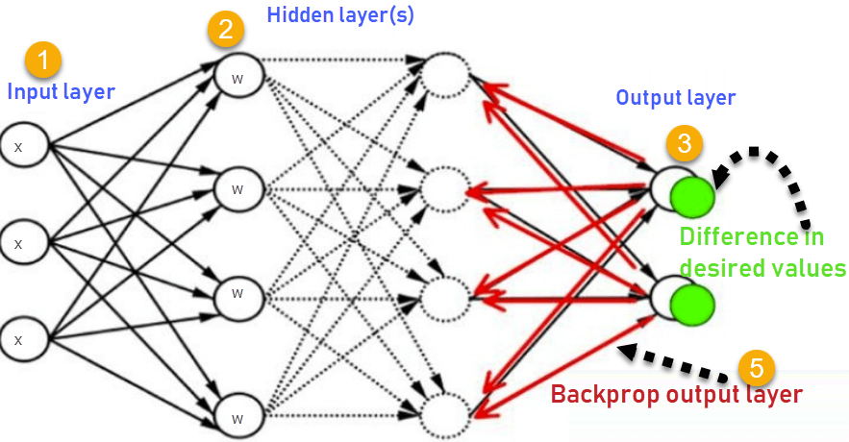
How Backpropagation Works: Simple Algorithm

Slide 8
1.Inputs X, arrive through the preconnected path.
Input is modeled using real weights W. The weights are usually randomly selected.
Calculate the output for every neuron from the input layer, to the hidden layers, to the output layer.
Calculate the error in the outputs.
Error_{B}= Actual Output – Desired Output
Travel bInputs X, arrive through the preconnected path
ack from the output layer to the hidden layer to adjust the weights such that the error is decreased.
Keep repeating the process until the desired output is achieved

Slide 9
Back-Propagation Network
What is BPN ?
• A single-layer neural network has many restrictions. This network can accomplish very limited
classes of tasks.
•
Minsky and Papert (1969) showed that a two layer feed-forward network can overcome
many restrictions, but they did not present a solution to the problem as "how to adjust the weights from input to hidden layer" ?
•
An answer to this question was presented by Rumelhart, Hinton and Williams in 1986. The central idea behind this solution is that the errors for the units of the hidden layer are determined by back-propagating the errors of the units of the output layer.
This method is often called the Back-propagation learning rule.
Back-propagation can also be considered as a generalization of the delta rule for non-linear activation functions and multi-layer networks.
• Back-propagation is a systematic method of training multi-layer artificial neural networks.

Slide 10
Back-Propagation Network
Real world is faced with a situations where data is incomplete or noisy. To make reasonable predictions about what is missing from the information available is a difficult task when there is no a good theory available that may to help reconstruct the missing data. It is in such situations the Back-propagation (Back-Prop) networks may provide some answers.
• A BackProp network consists of at least three layers of units :
- an input layer
- at least one intermediate hidden layer, and
- an output layer.
• Typically, units are connected in a feed-forward fashion with input units fully connected to units in the hidden layer and hidden units fully connected to units in the output layer.
• When a BackProp network is cycled, an input pattern is propagated forward to the output units through the intervening input-to-hidden and hidden-to-output weights.
• The output of a BackProp network is interpreted as a classification decision.

Slide 11

[Continued from previous slide]
• With BackProp networks, learning occurs during a training phase.
The steps followed during learning are :
− each input pattern in a training set is applied to the input units and then propagated forward.
− the pattern of activation arriving at the output layer is compared with the correct (associated) output pattern to calculate an error signal.
− the error signal for each such target output pattern is then back- propagated from the outputs to the inputs in order to appropriately adjust the weights in each layer of the network.
− after a BackProp network has learned the correct classification for a set of inputs, it can be tested on a second set of inputs to see how well it classifies untrained patterns.
• An important consideration in applying BackProp learning is how well the network generalizes.

Slide 12
Why We Need Backpropagation?
Most prominent advantages of Backpropagation are:
1. Backpropagation is fast, simple and easy to program
2. It has no parameters to tune apart from the numbers of input
3. It is a flexible method as it does not require prior knowledge about the network
4. It is a standard method that generally works well
5. It does not need any special mention of the features of the function to be learned.

Slide 13
What is a Feed Forward Network?
A feedforward neural network is an artificial neural network where the nodes never form a cycle. This kind of neural network has an input layer, hidden layers, and an output layer. It is the first and simplest type of artificial neural network.

Slide 14
Types of Backpropagation Networks
Two Types of Backpropagation Networks are:
Static Back-propagation
Recurrent Backpropagation
Static back-propagation:
It is one kind of backpropagation network which produces a mapping of a static input for static output. It is useful to solve static classification issues like optical character recognition.
Recurrent Backpropagation:
Recurrent backpropagation is fed forward until a fixed value is achieved. After that, the error is computed and propagated backward.
The main difference between both of these methods is: that the mapping is rapid in static back-propagation while it is nonstatic in recurrent backpropagation.

